Slide 1
Seminary Formation & the Deliverance Ministry
Notes:
I will discuss Mary’s role in an exorcism as well as our experience of related issues in an exorcism.
Much has already been said so I won’t go over the points already made
This is simply our own experience of about 7 years; active ministry being in a large urban capital. Calls pretty much every week. Most complain of demonic attacks- ie demonic oppression, not possession; many their own imaginings; some perhaps real; Demons do oppress us all the time; some rise to the level where real manifestations; unusual pains; bruises; scratches, and so forth. Some are just neurotic and want to ascribe these experiences to the demons- they are hoping for a quick fix. But there are a few cases each year which look like possession. Typically some sort of being involved with occult, or severe trauma in past- living in household where bad stuff happened;
What I will say is just from our experience; I don’t say you have to believe everything or that it is all necessarily true. The only thing exorcists agree on is to disagree. So, I don’t say this is all exactly true; it is just what our team has come up with at this point. But it’s been used over and over again with the cases we have. And I think what we do and have experienced is in consonance with the Church’s teachings; the general experience of exorcists and also of the literature. There is a growing body of modern literature and work which seems to be coalescing around some common principles and experiences in this work.

Slide 2
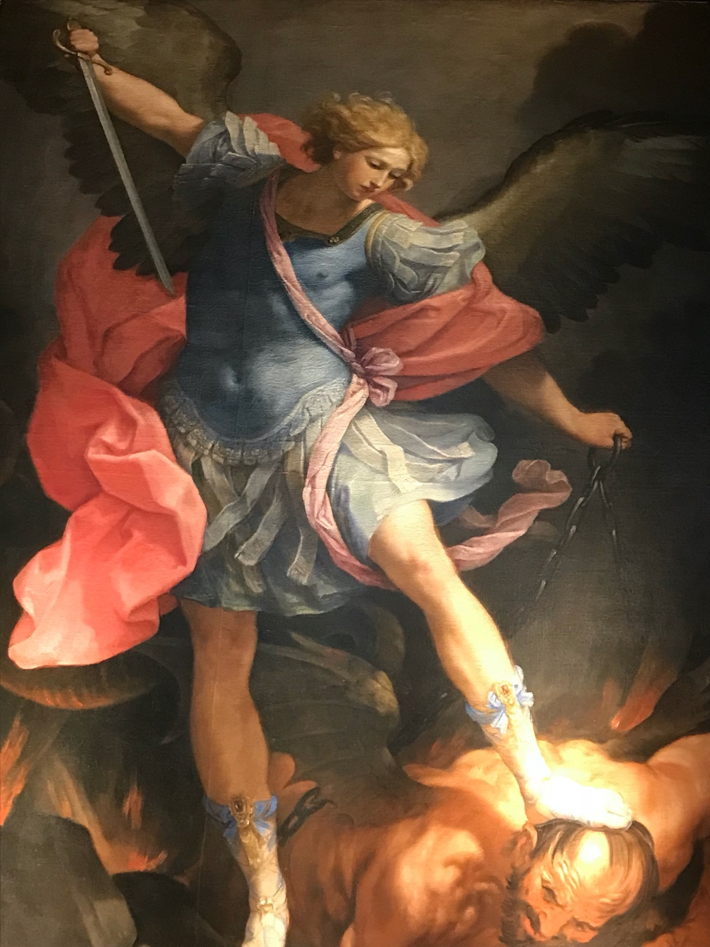

Slide 3
Binding Prayer
In the Name of Jesus Christ, our Lord and God, and by the power and authority of my priesthood, I invoke the full authority of the Church and the keys of St. Peter and I render all spirits impotent, paralyzed and ineffective in attempting to take revenge against anyone of us, our families, friends, communities, those who pray for us and their family members or anyone associated with us. I bind and sever and cut off all evil spirits, all powers in the air, the water, the ground, the fire, the underground, the netherworld, any satanic forces in nature and any and all emissaries of the satanic headquarters. I bind in the Blood of Jesus all their attributes, aspects and characteristics, all of their interactions, communications and deceitful games. I break any and all bonds, ties and attachments in the Name of the Father and of the Son + and of the Holy Spirit. R: Amen.
Fr. Ripperger, Minor Exorcisms & Deliverance Prayers: For Use by Priests, p. 20

Slide 4
Jesus conferred exorcist role on disciples:
The seventy[-two] returned rejoicing, and said, “Lord, even the demons are subject to us because of your name.” Jesus said, “I have observed Satan fall like lightning from the sky. Behold, I have given you the power ‘to tread upon serpents’ and scorpions and upon the full force of the enemy and nothing will harm you. Nevertheless, do not rejoice because the spirits are subject to you, but rejoice because your names are written in heaven.”
Lk 10:17-20
Notes:
Simple exorcisms

Slide 5
Importance of Deliverance Ministry
Casting out demons was an integral part of Jesus’ ministry
It was a sign and an essential part of the inbreaking Kingdom of God
Jesus passed his authority & ministry to us
If you don’t respond, they will go to the witchdoctors and occultists instead….

Slide 6
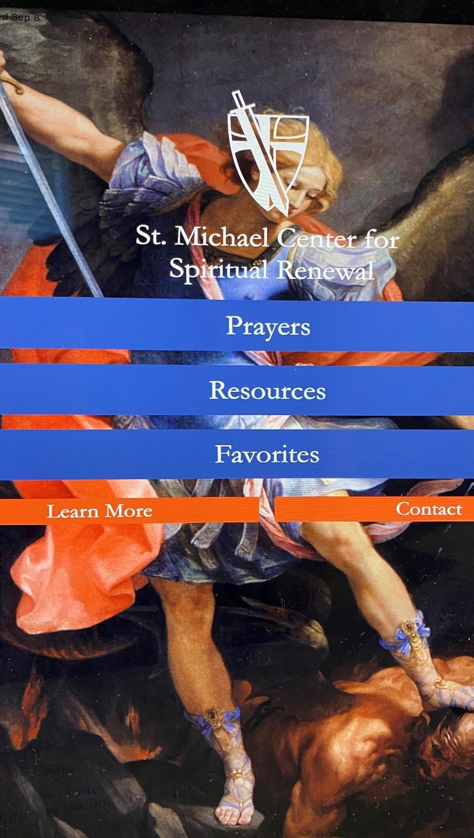
SMC app & website
Download APP:
“Catholic Exorcism”
Go to: www.catholicexorcism.org
Monthly online deliverance sessions: next is Nov 11th
See our “Pray With Me” short videos on our APP/Website

Slide 7
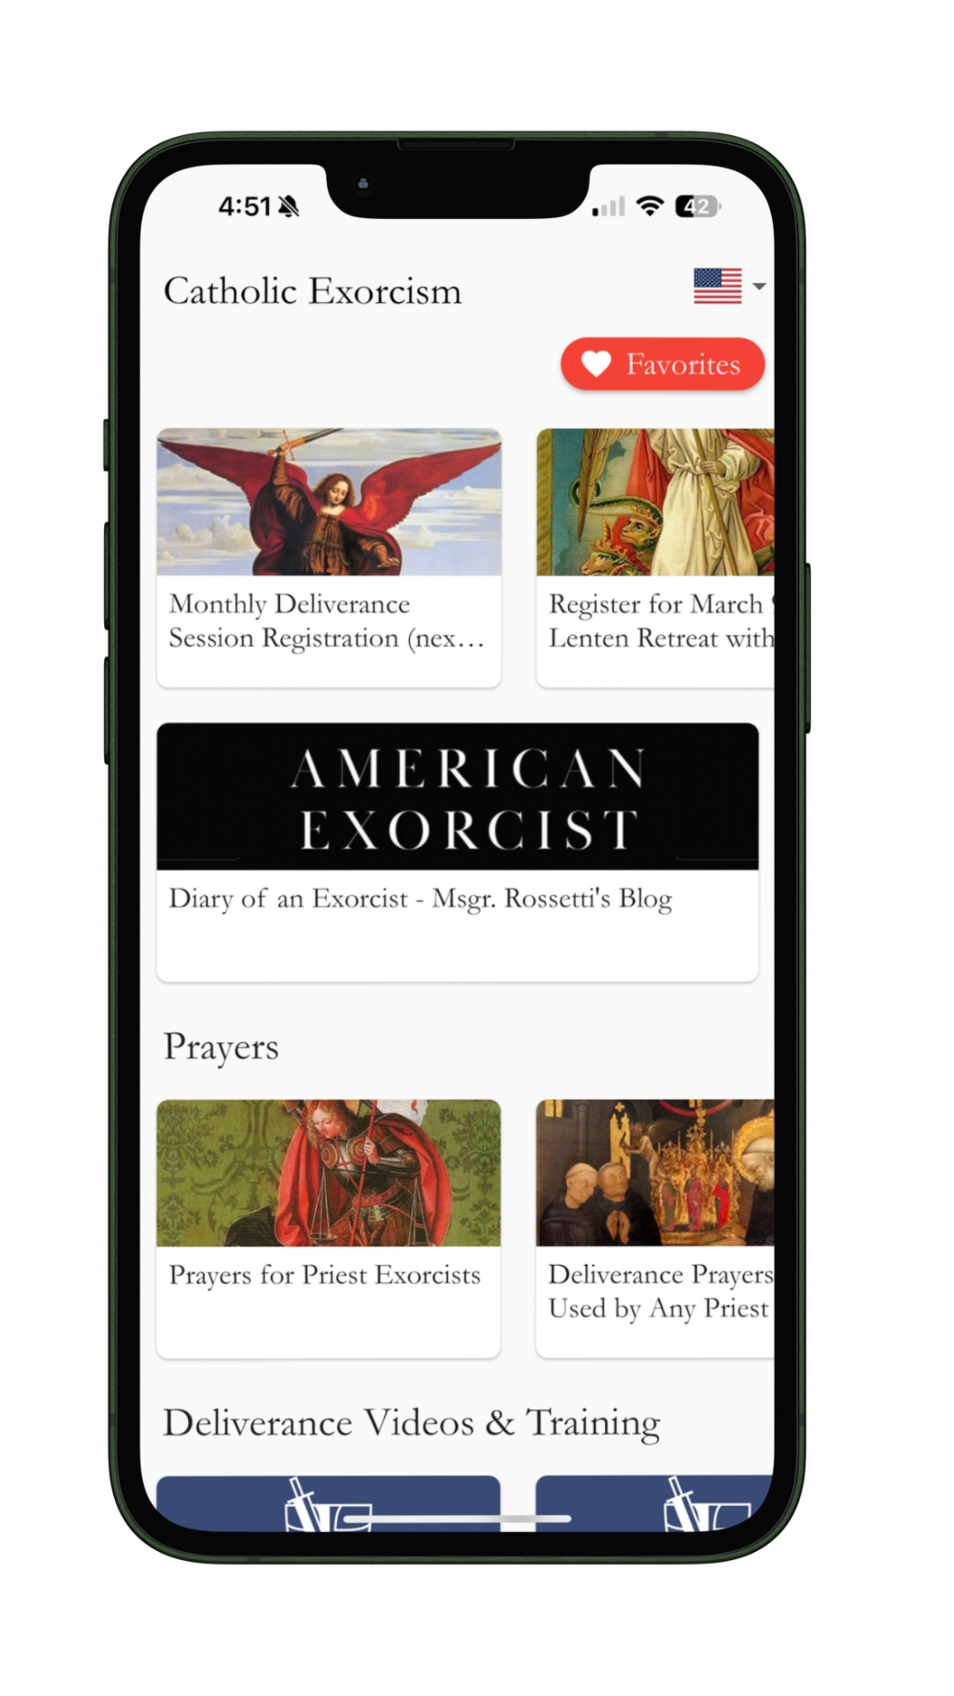




The App & Social Media
YOUTUBE: @stmichaelcenter
@Msgr.Rossetti
@Msgrrossetti
@Msgr.Rossetti
@Msgr.Rossetti
Beware of scammers asking for
donations for Africa.

Slide 8
Seminary Recommendation:
Future priests should be trained in the deliverance ministry. This will solve many confusions in seminary and beyond….

Slide 9
What should a parish priest know?
Church Teaching & Angelology & Demonology
What is the Deliverance Ministry
Discernment
The Process of Liberation and Healing
Demonic Infestation of Houses
Rise of the Occult, Witchcraft and Paganism
Curses and Cursed Objects
Interaction of the Psychological and Spiritual
Roles for the Laity
How to Conduct a Deliverance Session
Protecting Oneself and the Team

Slide 10
Satan’s
ordinary vs. extraordinary
works

Slide 11
What is the
Deliverance Ministry?

Slide 12
A Continuum Not Discrete Categories
Liberation <−−−−−−−>Perfect Possession
Notes:
Simple exorcisms

Slide 13
Deliverance Ministry
“Deliverance addresses some form of inordinate control being exercised over a specific aspect of a person's life; it concerns something more than ordinary temptation and less than the total control found in full possession….Silent prayers of deliverance can be offered by every Christian. If there is to be vocal prayer for deliverance, this should be done by a team whose ministry is recognized by the local community and its pastoral authority.”
—USCCB, A Pastoral Statement on the Catholic Charismatic Renewal, 29.

Slide 14
Seminary Recommendation:
A regular part of screening candidates for the seminary should include questions related to previous occult practices, non-Christian spiritualities, Santeria, voodoo, curses, spells, all forms of divinations and any other practice which might result in the candidate having “demons.”

Slide 15
Discernment

Slide 16
Is it:
Oppression
Obsession
Partial Possession
Possession
Notes:
It’s a continuum NOT discrete categories!!!!!!

Slide 17
Primary Signs vs
Secondary Signs

Slide 18
Question
Is it OK if a seminarian is conducting a deliverance ministry over other seminarians and training them to do so?

Slide 19
How do people get demons?
On-going serious sin
Occult behaviors e.g. Ouija, seances
Cursed by someone or ingesting cursed items
Dedicated to Satan/demons by self or family
Pagan religions--worshipping pagan “deities”
Witchcraft, sorcery and the like.
Demonic tattoos or contracts with evil
Traumatic abuse in childhood
Opening self to un-named spiritual forces/energies

Slide 20
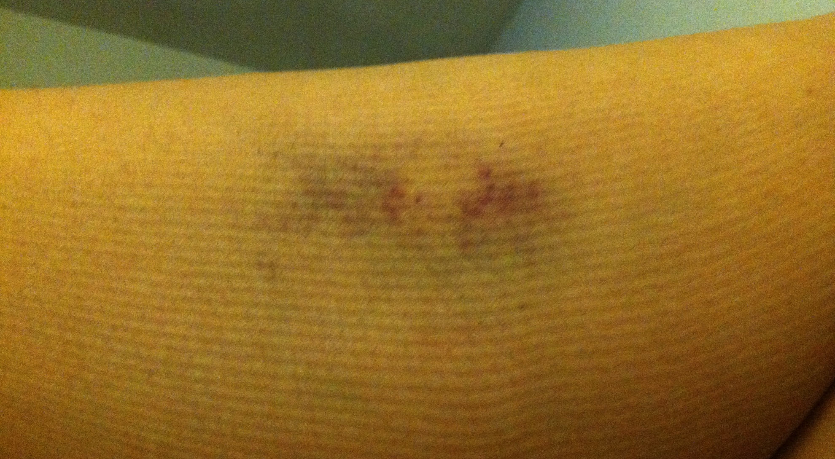
Bruises on a Possessed Person

Slide 21
Classic Signs of Possession
Aversion to the sacred (demons can’t stand anything holy ie related to God)
Ability to understand/speak unknown languages (demonic intellectual abilities)
Occult knowledge (demonic intellectual abilities)
Preternatural strength (demonic physical abilities)

Slide 22
Basic Discernment…
Answer two questions:
*Why you? (why do you have demons?)
*Why now? (why are they manifesting now?)

Slide 23
Demon Brain
Possessed or severely obsessed people can exhibit demonic thinking. The stronger the demonic presence in a person the more they start thinking like demons.

Slide 24
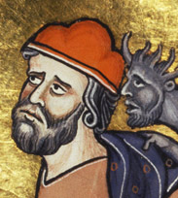

Slide 25
Six Common Demonic Messages:
Demon Brain
There is no hope for you.
You are an awful person..disgusting.
God doesn’t care about you.
You’re mine. I will never leave.
You are going to hell.
You should kill yourself.

Slide 26
Dealing with Demonic Obsessions
Disappropriation

Slide 27
Dealing with Demonic Obsessions
*Scrupulosity/OCD or Obsessions? Or both?
*Medications & Therapy
*Don’t overreact
*Gentle refocusing on the holy
*Daily Scriptural meditation
*Daily deliverance prayers: “Pray with Me”
*Priest pray over you if needed (3-5 sessions)
*Be a peace with frail humanity: Jesus saves us

Slide 28

Expelled during an Exorcism

Slide 29
Question
If a seminarian “manifests” a demonic presence while in the seminary or is in need of deliverance prayer, should he be in the seminary or take time off?

Slide 30
Seminary Recommendation:
Seminarians with a “mild” case of demonic oppression/obsession can be quickly delivered with a few sessions. But those with severe oppressions and/or possession should take time away from formation. Most will probably not return.

Slide 31
You have the authority!
The vast majority of cases that arise are not full possession
but rather oppression/obsession/partial possession. Priests in good standing have faculties to pray over these people.

Slide 32
After some initial prayer sessions:
The person may:
1. Start feeling progressively better (oppression cases);
2. Feel worse, especially a few days after the session (possession cases);
3. Experience no change (likely no demons present).

Slide 33
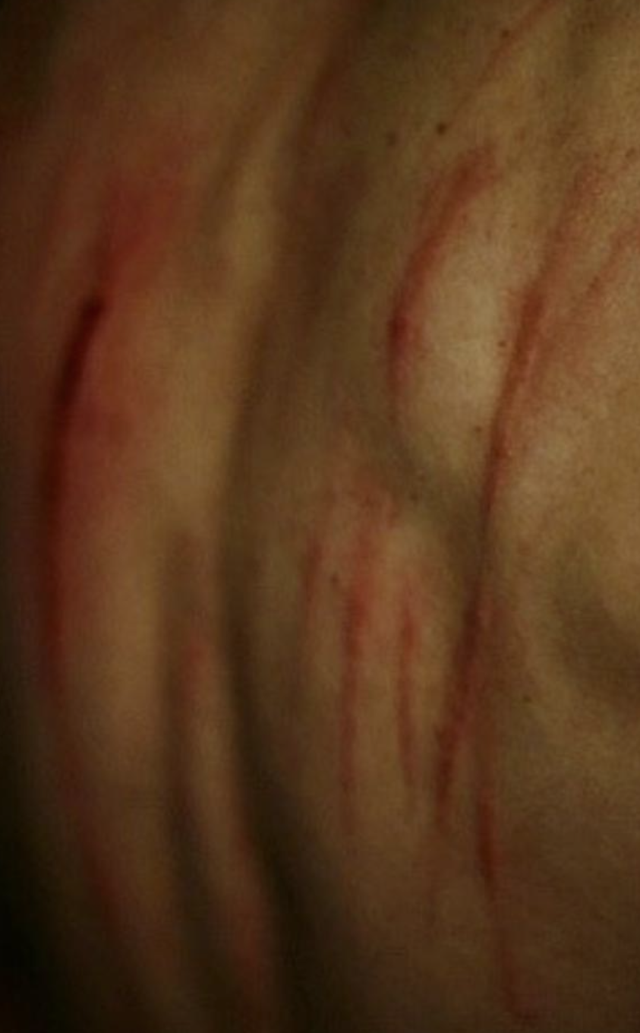
When to call the exorcist?
Signs of possession
Demonic personality comes forward
Person goes “out” when prayed over
Individual reacts strongly to holy objects
Person gets “worse” when prayed over, ie manifestations increase

Slide 34
Tip for Discernment
Be patient with diagnosis. The truth will out eventually.

Slide 35
The Process of
Healing & Liberation

Slide 36
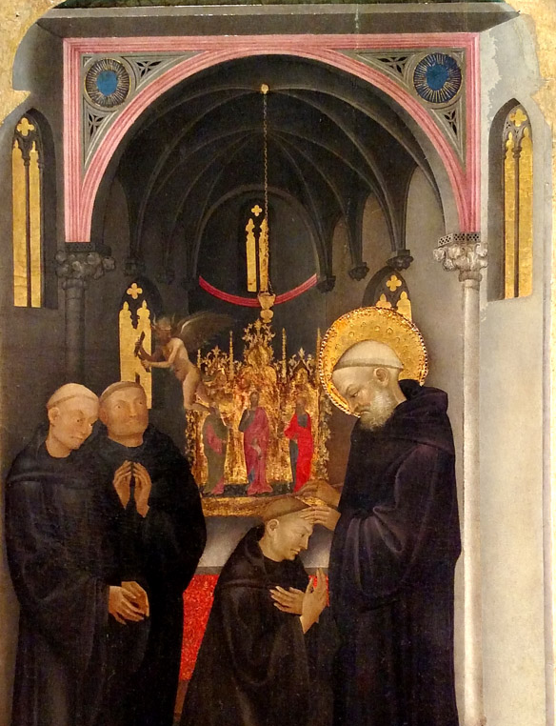
St Benedict exorcizes a possessed monk

Slide 37
Forgiveness and purification are not the same thing.
Notes:
sins are instantly forgiven but the process of purification takes time; hence the Catholic notion of purgatory; there is no cheap grace as Bonhoeffer would say; we should be wary of sin; don’t think well I will just confess it and it’s all over with—sure the sin is expunged but its evil effects linger in the world and in us. And the demons can hang on until the traces of evil are gone…. (story demon on eye: as we will see, we have an individual sees demons so it helps us in our discernment---individual had demon attached to him—not possessed but connected (demons do attach to parts of individuals—recall St Catherine of Siena say a demon wrapped around a priest’s throat; demon on eye—individual using internet porn and video games….prayed over him for hours—slowly stopped this…but it took MONTHS, and he wasn’t’ even possessed…). Never underestimate the long term effects of sin—don’t just think to yourself--- I’ll go to confession and it’s over…yes, the sin is forgiven but the damage caused by sin can be great and takes a long time, if ever to purge it….
story building exorcism: we are exorcizing a couple of sites where frankly religious were doing a lot of bad things; it has been many many years since but the demons are connected to that place and dug in….we are using gallons of holy water and the Rite and it takes a long long time..
In same way, Mary can show up personally in an exorcism, she has done so several times, but it doesn’t mean the exorcism is over; she can come as a support and encouragement.

Slide 38
Making the Energumen an unwelcome place for demons:
Regular reception of sacraments
Daily prayer and perhaps auxilium christianorum
Make connections with others (reduce isolation)
Letting go of inner angers
Forgiving those who wronged you
Being grateful

Slide 39
Unforgiveness, Rage & the Demonic
*Process and work through unforgiveness
*Process and work through internal anger
*These feed the demons and the process gets stuck!
How to do this?

Slide 40
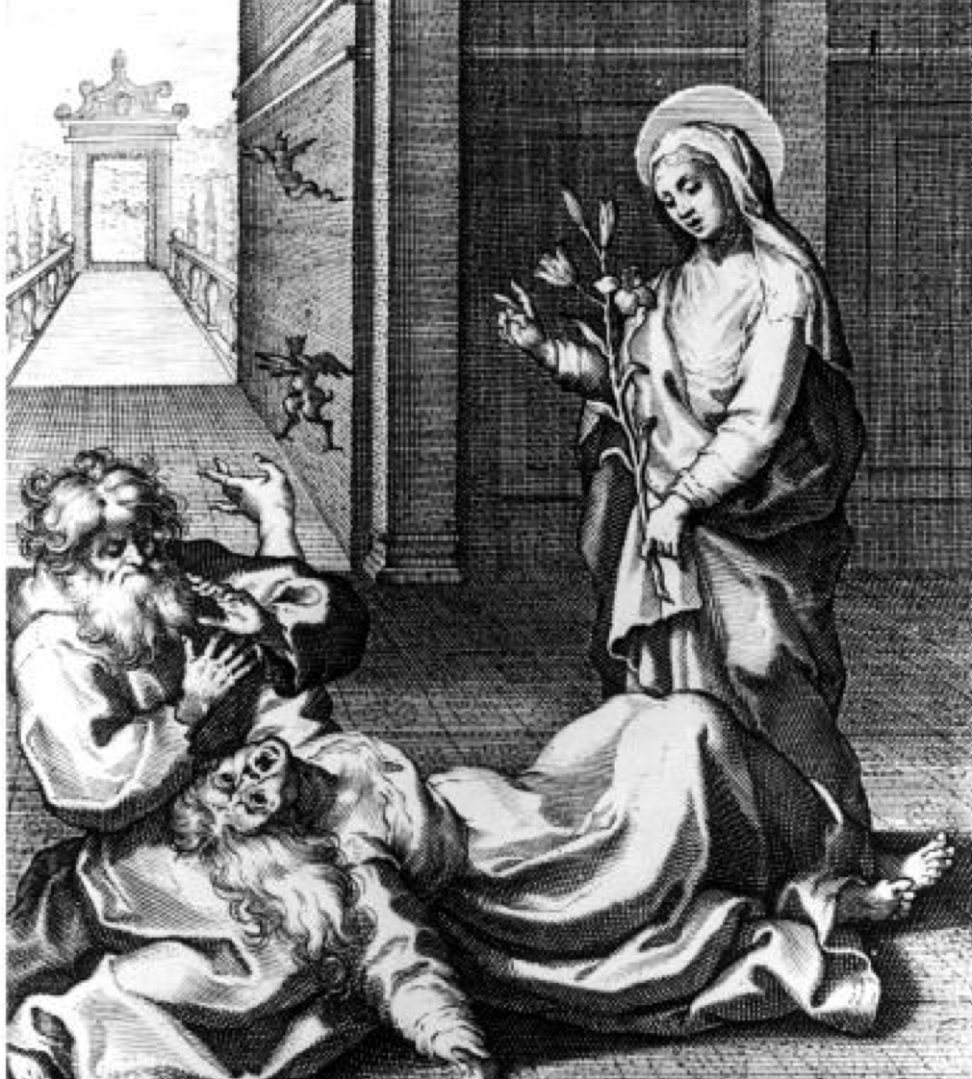
St Catherine Exorcizing

Slide 41
The majority of the time a combination of both spiritual and psychological healing is needed.
A Catholic psychotherapist?

Slide 42
Rise of the Occult, Witchcraft and Paganism

Slide 43
Seminary Recommendation:
Be alert to seminarians with a previous history of divination (e.g. casting curses and spells, witchcraft, Ouija boards, mediums). These evil spirits are hard to expel and typically hang on.

Slide 44
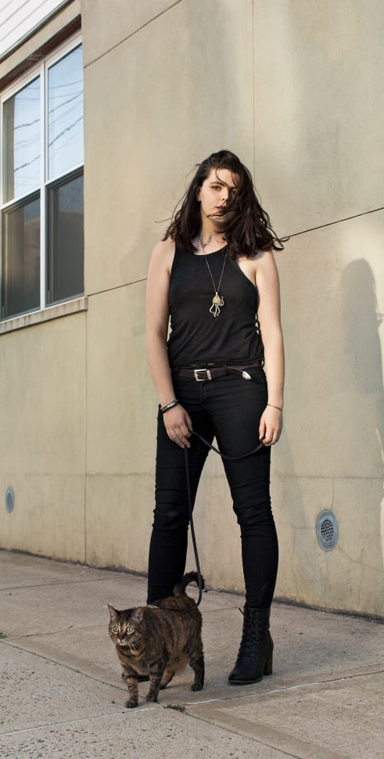
modern witchcraft
#Witchtok has over 42 billion views (as of Sept 2023)!

Slide 45
How about---
Reiki and other similar “energy” healing
Freemasonry
Harry Potter?
Yoga
May I do Eastern meditations?

Slide 46
If you were once a member of a Masonic organization or are a descendant of someone who was, it is recommended that you pray these prayers. It is advisable to read it through first so you know what is involved. It is best to pray this aloud in the presence of a witness who is a practicing Catholic. Fr Ripperger, “Minor Exorcisms and Deliverance Prayers” p. 439

Slide 47
Are these symptoms psychological or demonic?
Option 1: The demonic presence mimics psychological symptoms.
Option 2: The demonic presence exacerbates already existing psychological weaknesses.
Option 3: The psychological symptoms are independent of the demonic presence.
Option 4: The people blame demons for their psychological problems.

Slide 48
Roles for the Laity

Slide 49
Can the laity cast out demons?
Yes … but
Should the laity lay hands on people?
Be careful who you let pray over you and/or lay hands on you.
Those without special authority should use deprecatory prayers, not imperative prayers, as a matter of pastoral prudence.

Slide 50
“An Italian exorcist told of an episode involving members of a Catholic charismatic prayer group who thought they had a special “gift” to cast out evil spirits. During the exorcism, the charismatics were laying on hands and talking to the demon, ordering it to comply. Without warning, the demon turned on them saying, “Who are you?” Then he launched a bookcase at them, sending them all to the emergency room with injuries.” Baglio, The Rite, pp. 79-80

Slide 51
Imperative vs. Deprecatory Prayers
  Imperative prayers involving commanding demons requires authority. Deprecatory prayers is when we invoke God or Mary or an angel or a saint to cast out the demons.

Slide 52
Special authority over demons
(ie. I can command you to leave)
Authority by charism
  (e.g. saints)
Authority given by the Church/Ordination
  (e.g. exorcist, priest)
Authority by natural law
  (e.g. over children, spouses, self, property)

Slide 53
Question
A seminarian believes he is receiving inspired “words” for others and receiving ”prophecies”. He is praying over others and sharing his prophetic inspirations. What should be the response of the seminary?

Slide 54
How to work with spiritual “intuitions”
Satan- beware of those with an occult background. It could be the: “occult third eye.”
God
Self

Slide 55
A number of priests have been led astray by false mystics/sensitives or their own “gifts” where those “gifts” were either mental fantasies or demonic manipulations.

Slide 56
Spiritual intuitions/words of knowledge etc are always secondary to the role of the priest and the teachings of the Church. They can contain information that may be helpful but always in a secondary role. They should not be leading or directing the course of the deliverance ministry.

Slide 57
*Spiritual arrogance
(antidote: refer everything to Jesus)
*Get way in over one’s head
(antidote: be supervised by a senior priest)
*Led astray by false spiritual sensitives
*Becoming overinvolved (time and emotionally) with the case/person (antidote: good boundaries)
*Sexually involved with the woman
(antidote: old exorcists ☺)
*Fascination with evil
Dangers for the Priest
Notes:
Demons target is often the priest
Usually women
Often women who are psychologically damaged and needy

Slide 58
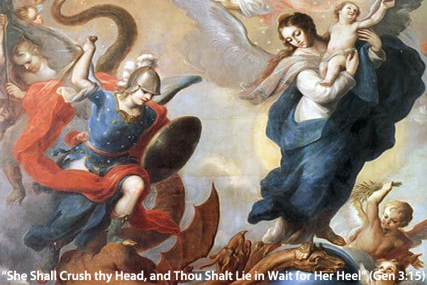

Slide 59
Cleansing Prayer
Heavenly Father, in the Name of Jesus Christ our Lord and Savior, by the power of the Holy Spirit, we pray that the cleansing power of the precious blood of Your Son come upon us right now. Purify us and wash us clean with the blood of Jesus from the top of our heads down to the very soles of our feet. Let this blood penetrate the very marrow of our bones to cleanse us from any entanglement from whatever evil spirits we have come in contact with during the course of our session. Anoint us with the gifts of the Holy Spirit and refresh our body, soul, and spirit, and may the sign of Your holy cross drive away all evil spirits from us. In the Name of the Father + and the Son and of the Holy Spirit. Amen.

